Slide 1
The Calisto Infinite
Narrative Design Document

Slide 2



Synopsis
2350, as colonization of the solar system progresses, research leads to the discovery of an extraterrestrial civilization living in Venus upper atmosphere. Rumors of the potential resources to be found began, small groups of the richest company goes on expeditions.
Wikus Lee, a bounty hunter, is sent to find Andrew Bradman, a wealthy explorer, and discovers a city that seems utopian, but is filled with explorers infected by a strange virus that is gradually turning them into alien creatures.
X
X

Slide 3
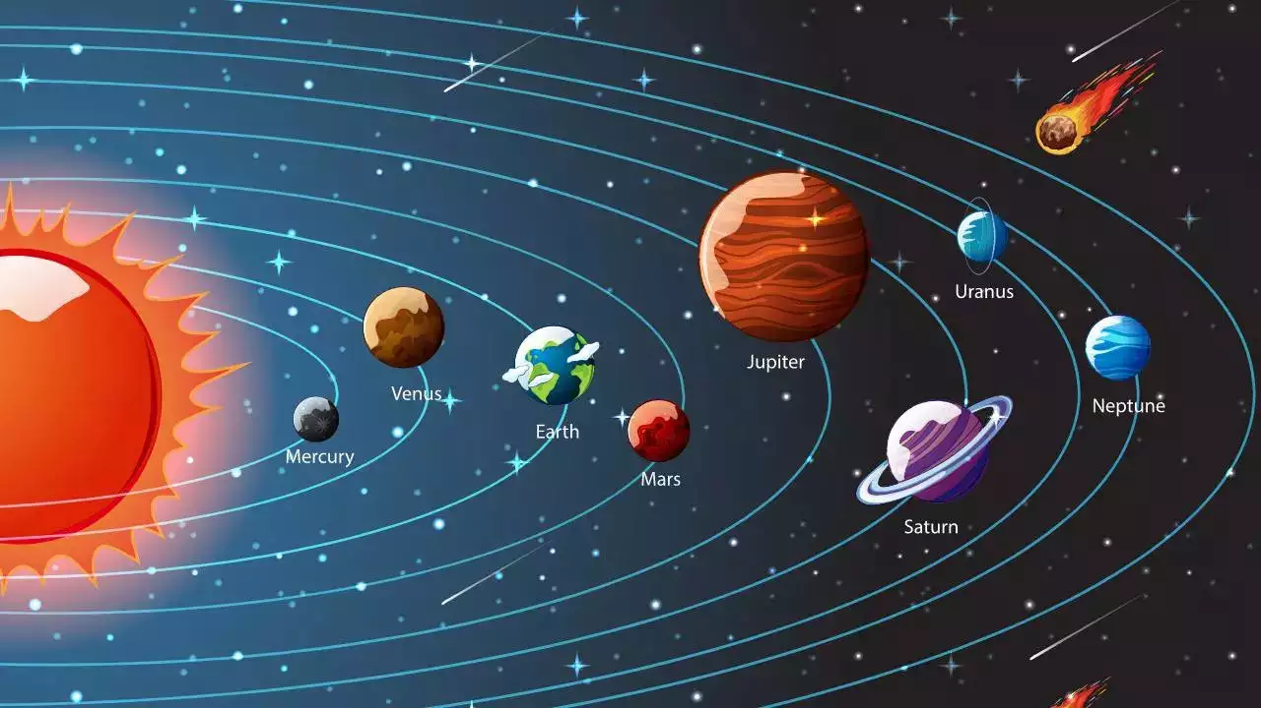
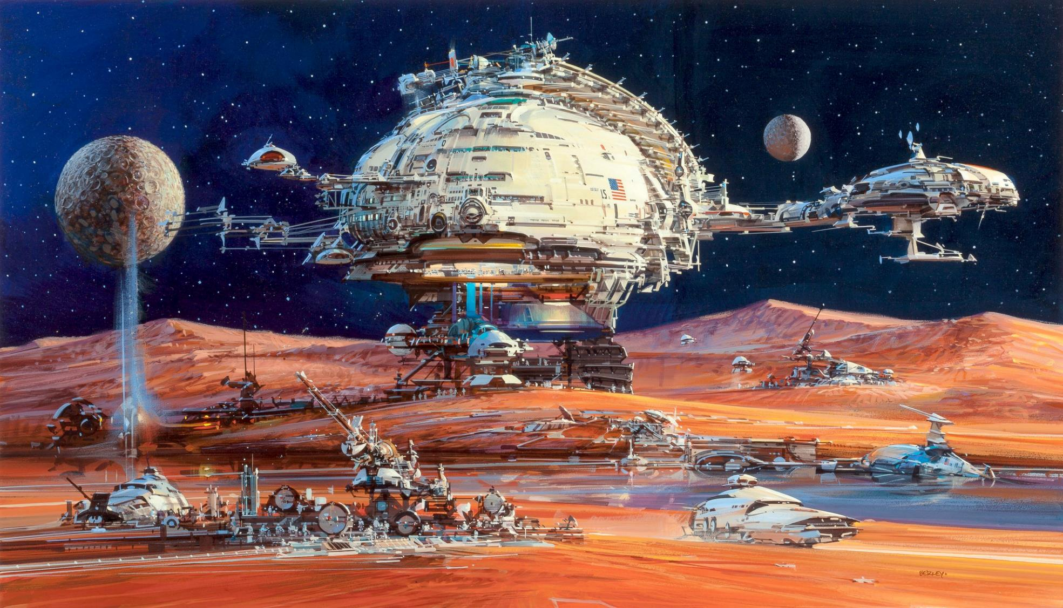
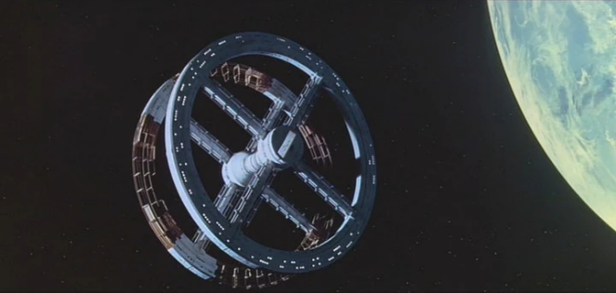
Lore – solar system
Colonised in solar system:
- Mars
- The moon
- Calisto & Europe (Jupiter)
- Some space stations
Colonised planet are mainly used to extract resources and commercial uses but some structures are made for travel, prisons or habitations for the richest ones.
Most of the people still live on earth and cant leave it.
It’s very hard to colonised new planet, only really rich people can do it and they need to be sure that there is enough resource to be worth.

Slide 4
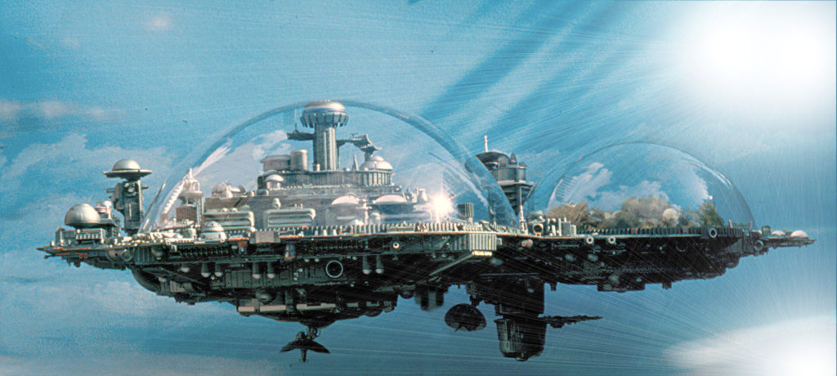
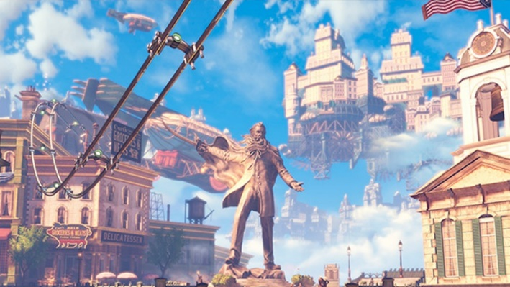
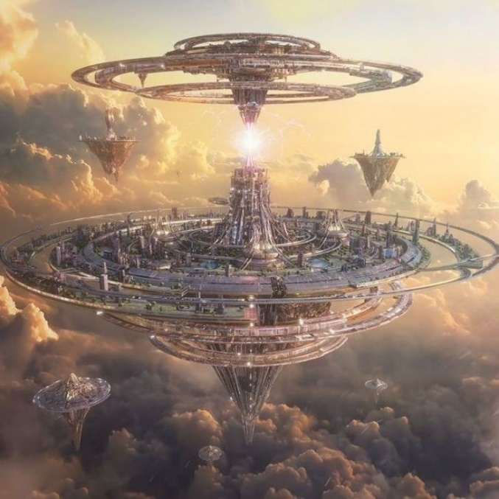
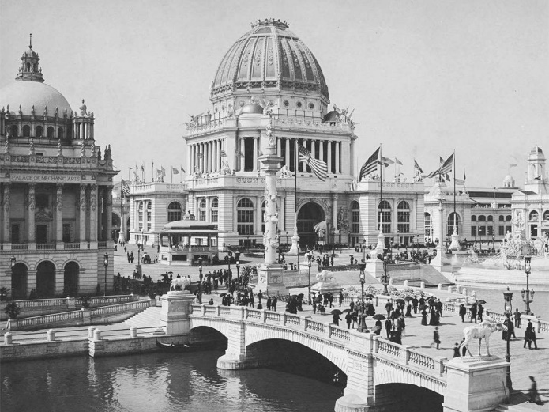
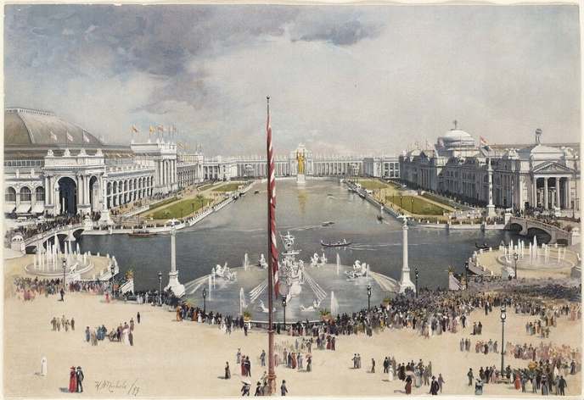
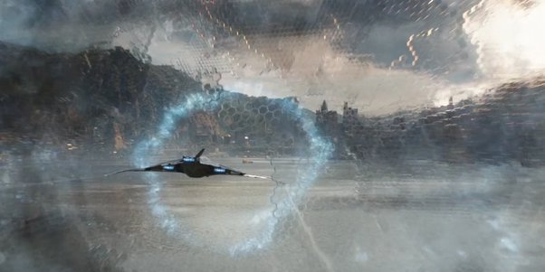
Venus City: Columburgh
Alien were inspired be 20’s 30’s human constructions.
Alien were spying for thousands of years on earth and human evolution
Alien were hidding from human because they were affraid of what humans could do with their technologies and resources.
https://fr.wikipedia.org/wiki/Colonisation_de_Vénus#:~:text=La%20colonisation%20de%20Vénus%2C%20la,favorable%20à%20la%20présence%20de
https://www.numerama.com/tech/240108-conquete-de-lespace-faut-il-construire-des-cites-volantes-sur-venus.html

Slide 5
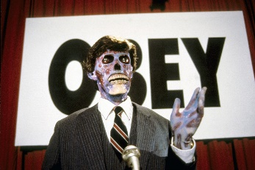
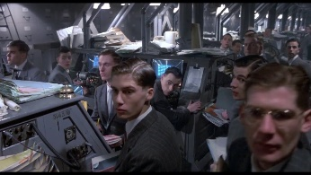
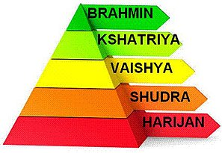
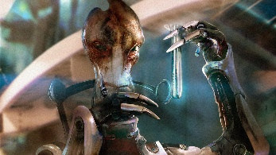
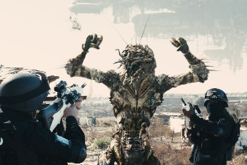
Venusian system - Caste
Leader
Leader
Scientist
Worker
Manager
Manager
Scientist
Inspired by Indian caste system
Worker

Slide 6
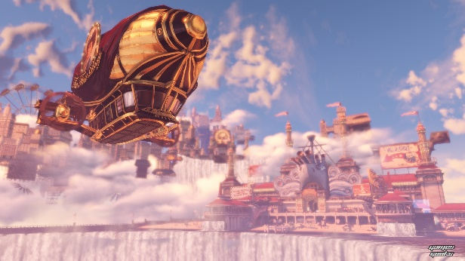
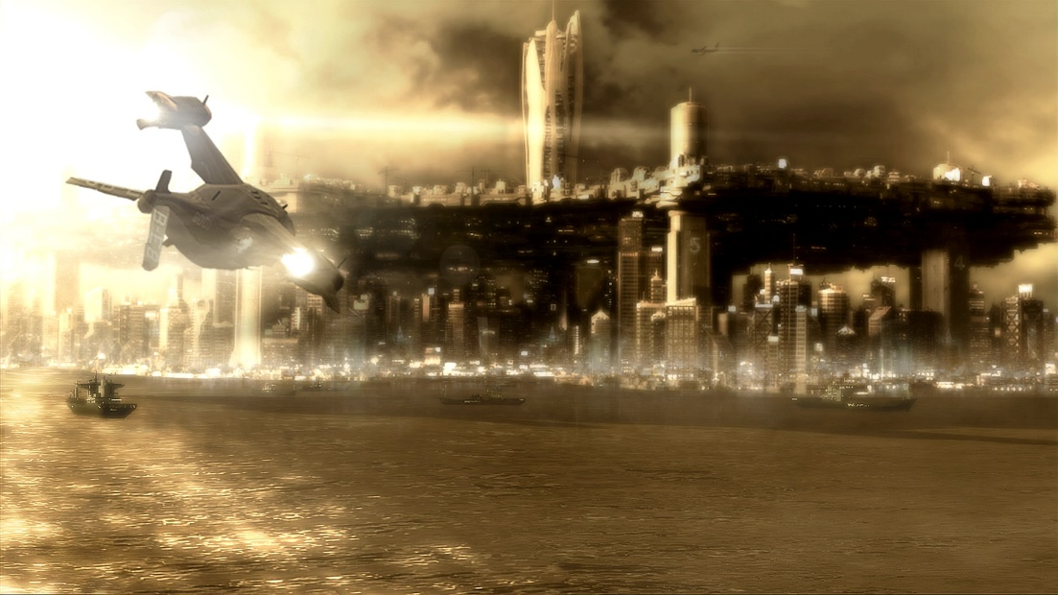
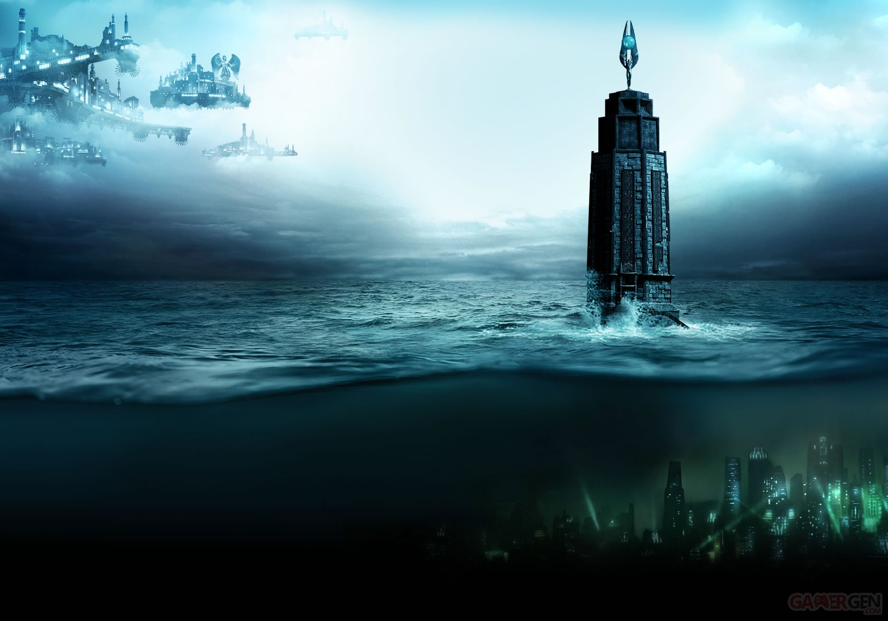
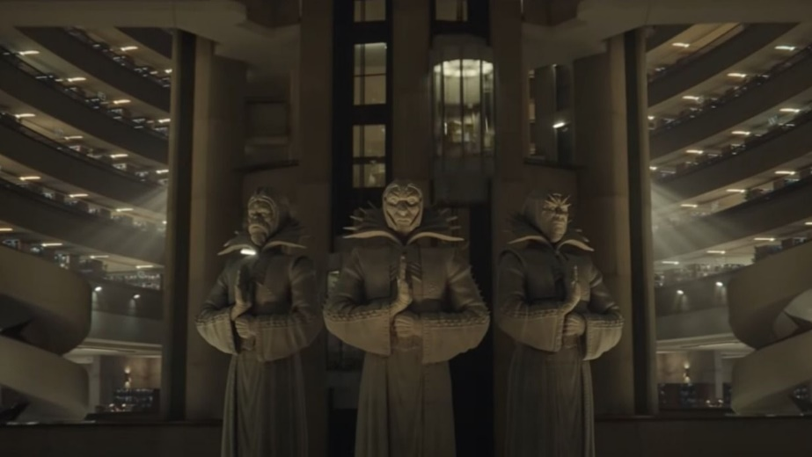
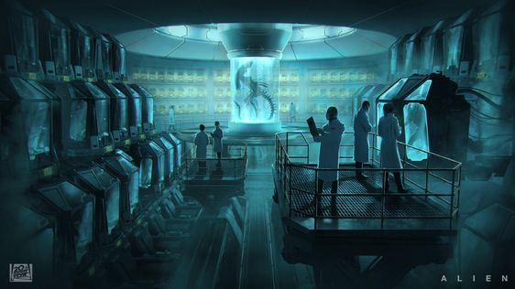
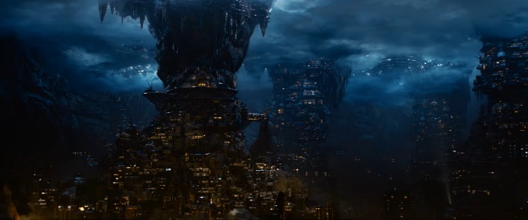
Caste - Floors
Each caste has it’s own floor
Prime City
Leaders lives in a main city that seems to be utopian
Theme: Air
Architecture: Neoclassical
Sublock
Managers lives just under Prime City in brutalist architectures
Theme: Earth
Architecture: Ecobrutalism
Rapturopolis
Some laboratories are hidden under manager floor, this is the biggest floor to prevent worker to go higher
Theme: Water
Architecture: Futurist lab
The station is split in 4 differents floor.
The lower levels are the worst they are with more gravity and higher temperatures.
There are differents access between floors that can be used by people depending on their castes and their roles.
Each floor has a specific architecture and a theme based on one of the 4 elements.
The Depths
The workers live at the lowest level where the conditions are the most extreme
Theme: Fire
Architecture: Slums

Slide 7

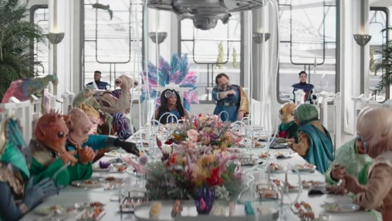
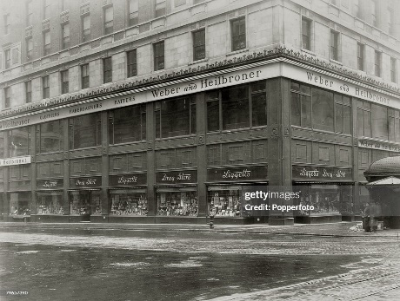
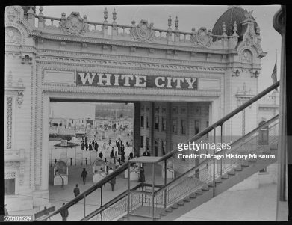
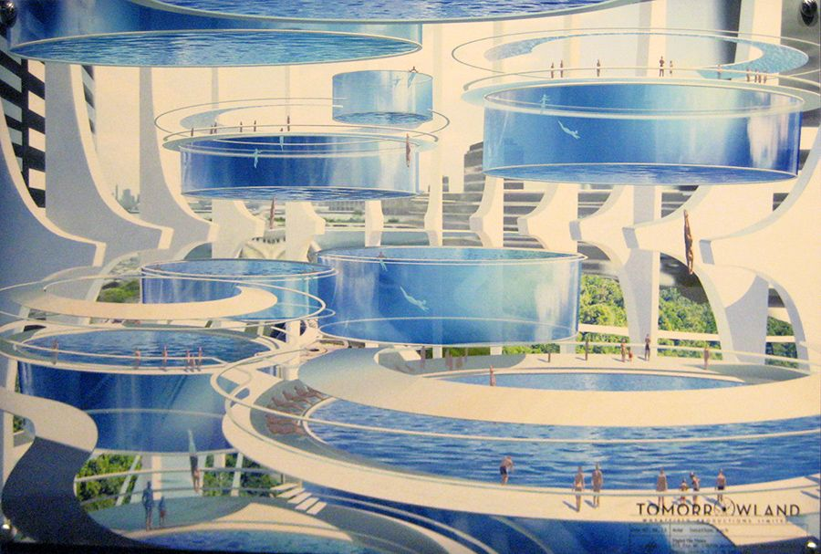
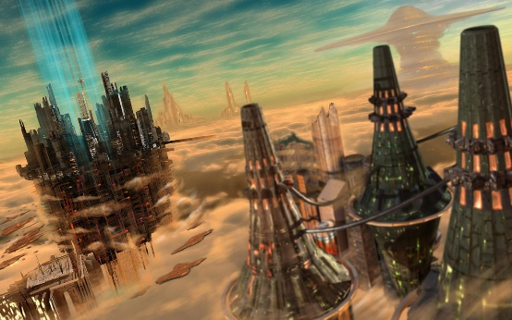
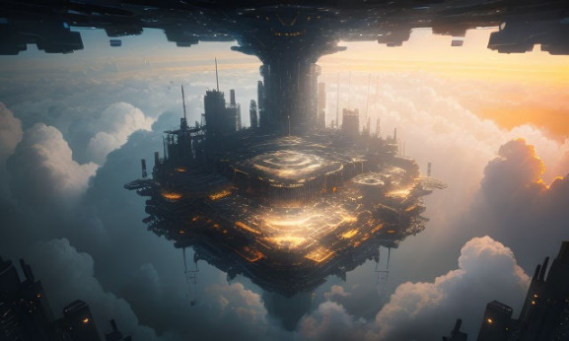
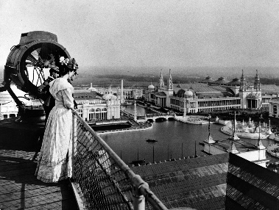
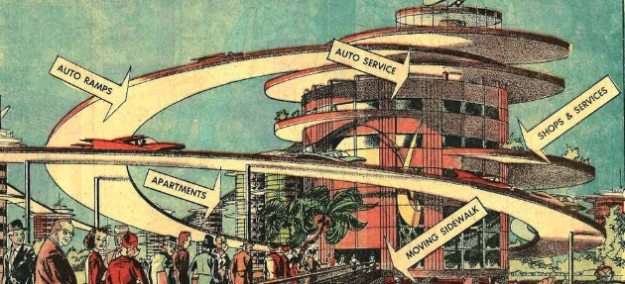
Caste - Leader
Wealthy, dont have to work. Almost considered as gods, feared by other caste. Never have to see worker, they have most of the developed technologies.
Dedicated to art and luxury.
Usually go tu luxury restaurants, casino, theater and other entertainement places including some with powers use.
Live in upper cities, using almost all technologies and entertainment with the best infrastructure.

Slide 8
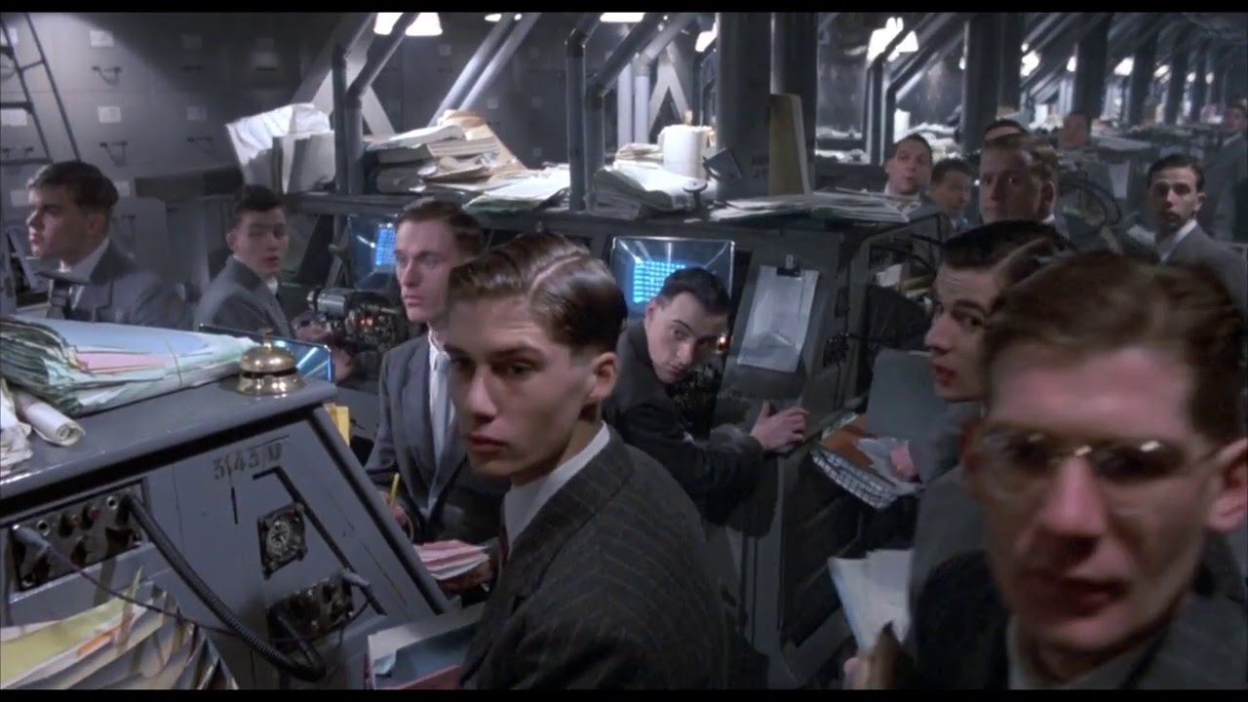
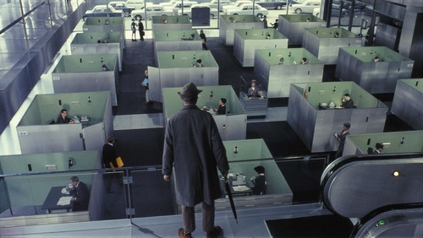
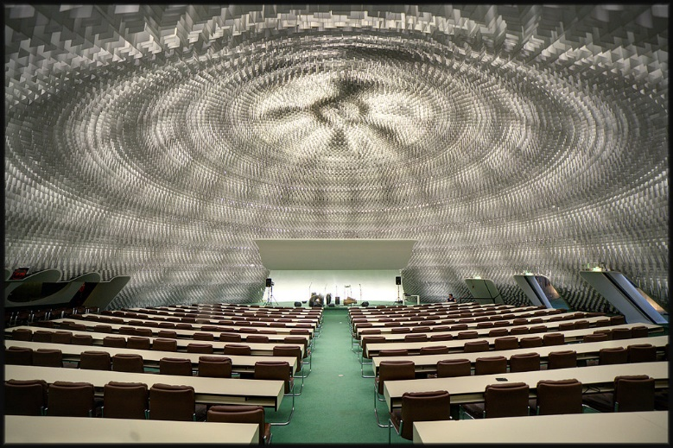
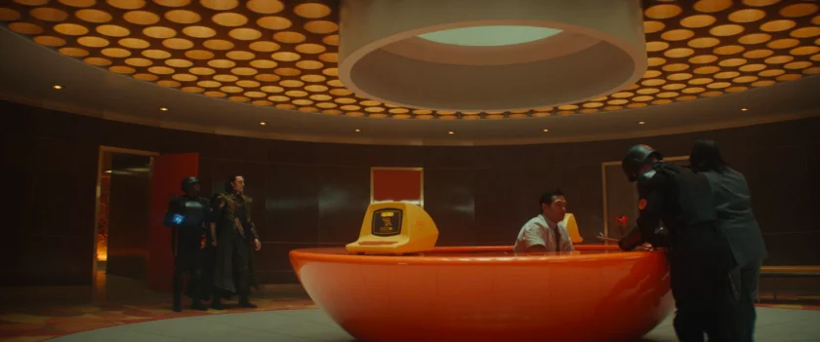
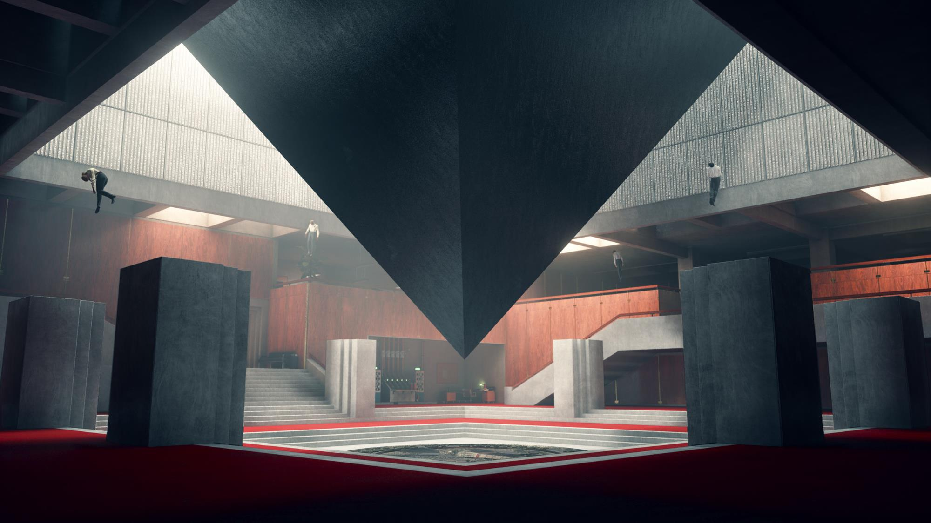
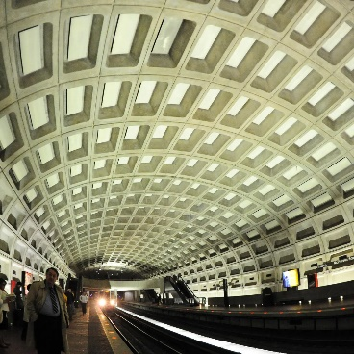
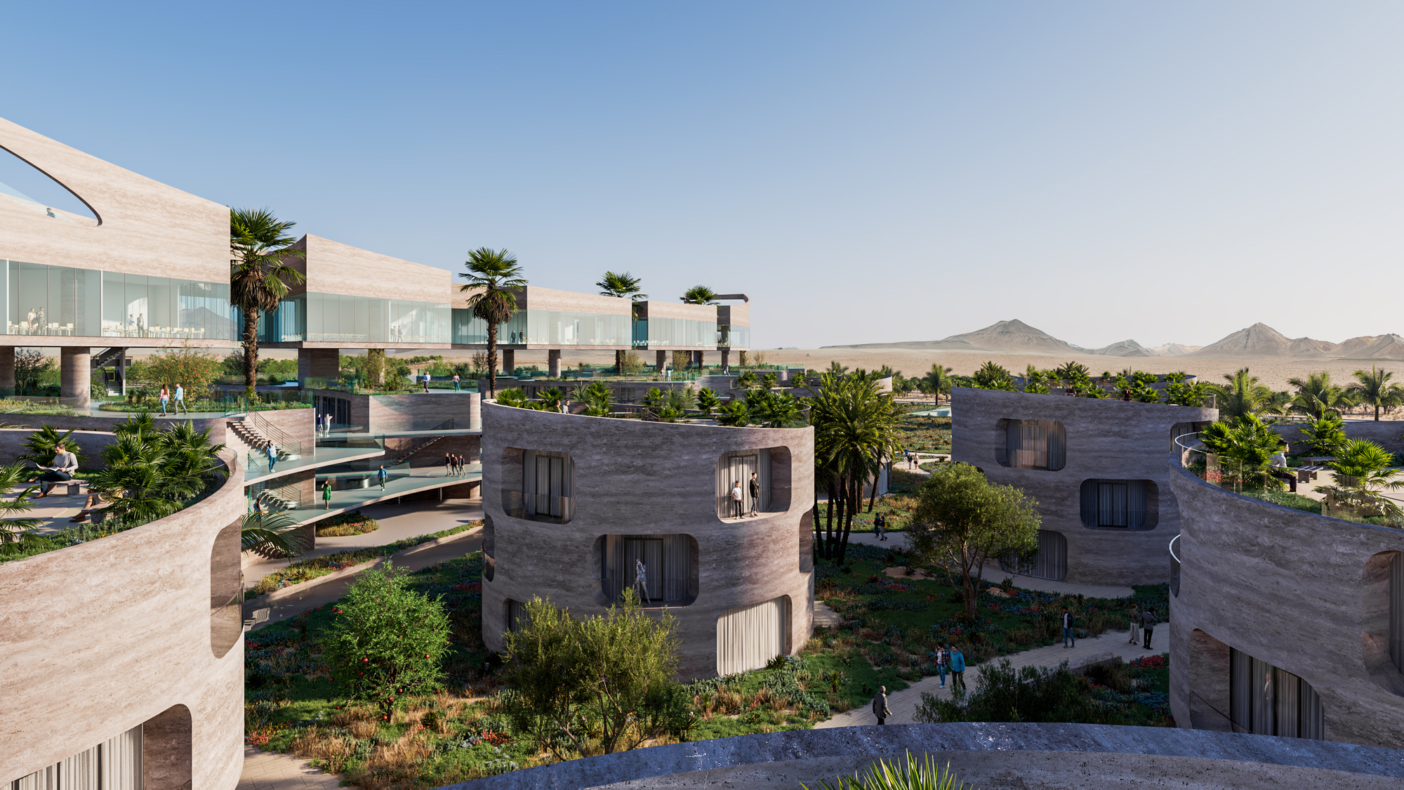
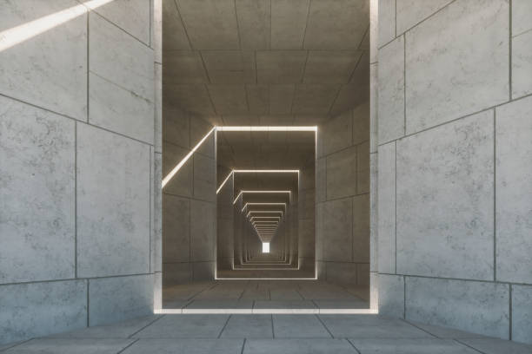
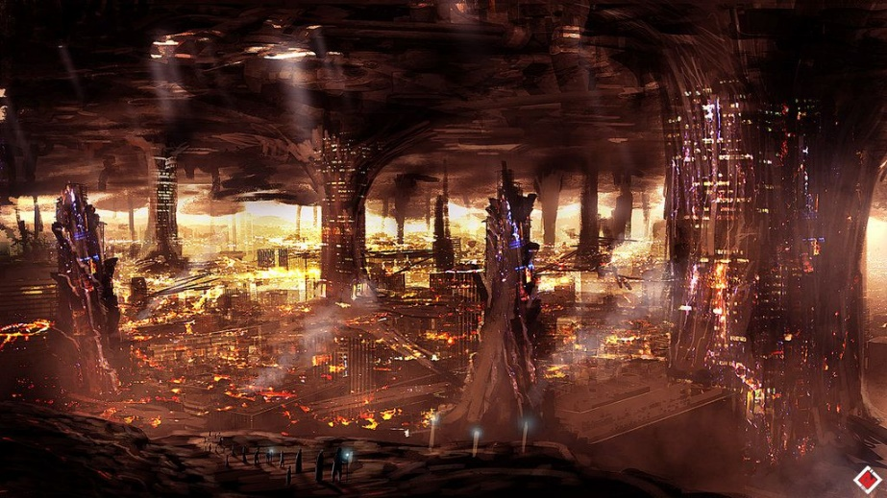
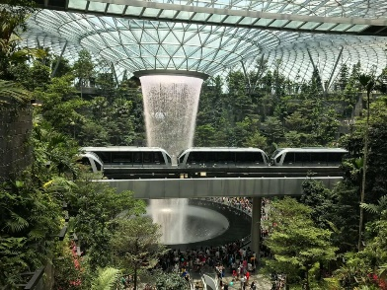
Caste - Manager
Sell worker’s resources to leaders
Can also be military to keep worker and scientist at their places, usually with powers and weapons.
Have a pretty good standard of living.
"Dehumanised", need to please leader to keep their places.
No real culture or entertainement, most of the time the leader’s one.
Live under cities in brutalist style architecture. They can go to cities, most of the time for business

Slide 9

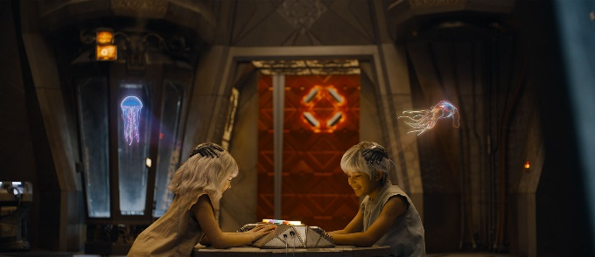
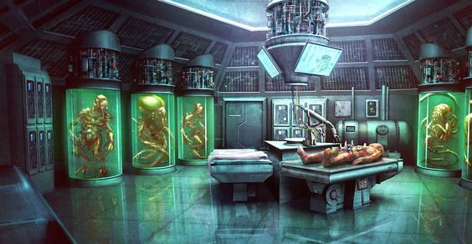
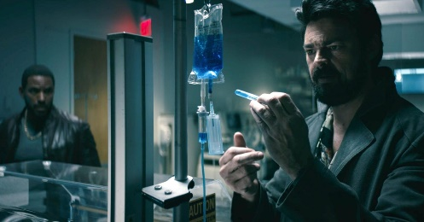
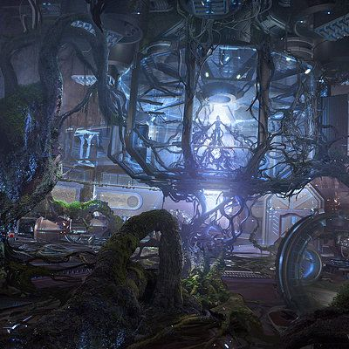
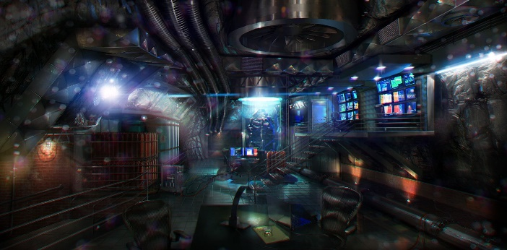
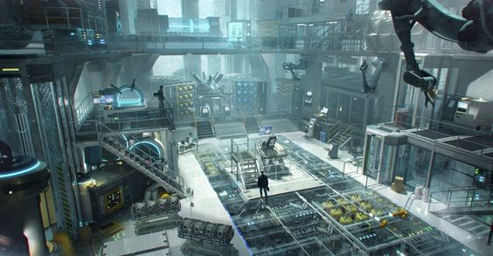
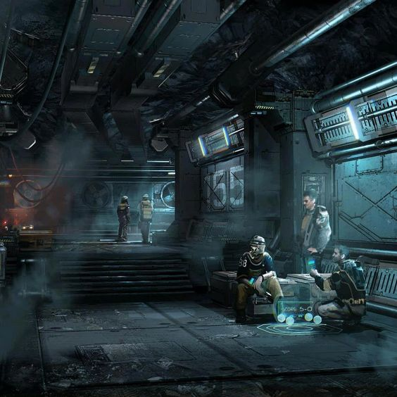
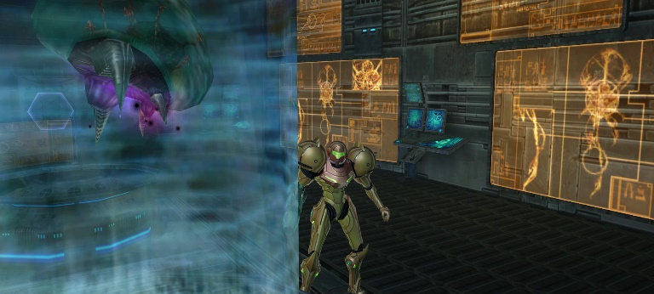
Caste - Scientist
Make experience and test product on workers
Some really want to make their experiences, some try to change things but most of them just do their jobs.
Dont really have a lot but most of their lifes is focus on their works.
Have just what they need to live but not much more, almost no access to entertainment.
Live at a special hidden floor, kept secret to workers

Slide 10

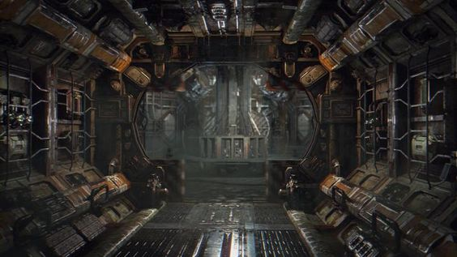
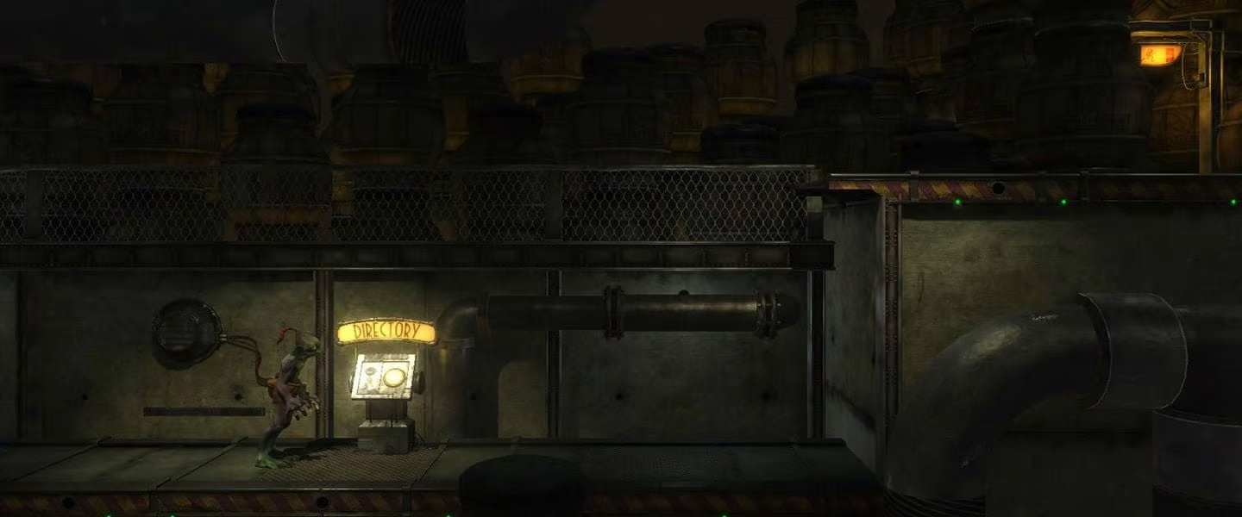
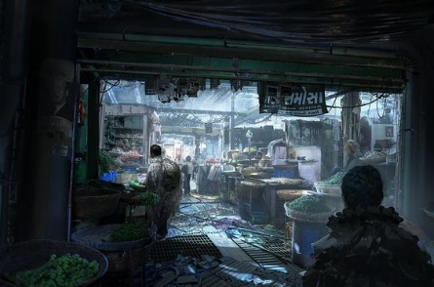
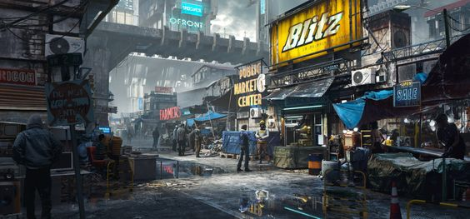




Caste - Worker
Exploited, has to work for the manager. Sometimes try to revolt but are stopped by the managers.
Has the lowest life expectancy and regulars accidents.
Can never go to other floor except when they are chosen to make experience for the scientist.
Have no access to powers or weapon.
have a despised local culture.
Live at the lowest level of the station with the poorest living conditions, highest temperature.

Slide 11


Characters – Main character
Name: Wikus Lee
Age: 34
Gender: M
Goal: Making contracts
Conflicts: Face danger but never consequences
Key life events: has been abandoned
Fears: Losing its humanity
What they value most: Honest work

Slide 12



Characters – Characters to rescue
Name: Andrew Bradman
Age: 42
Gender: M
Relationship to key characters: Beware, want to use him
Goal: Colonise Venus
Family: Wealthy from diamonds extractions on Neptune atmosphere
Education: Biggest economic/business school
Physical description: Elon Musk
Fears: Losing power
What they value most: What he call “potential” in humans

Slide 13



Characters – Alien scientist
Name: Sunev
Age: 105
Caste: Scientists
Goal: Remaining the “main” scientist of Venus
Family: Wealthy among scientists
Education: Very developped
Physical description: “Classical” alien creature with technological suit
Key life events: Has developed serum to live longer
Fears: Losing statut
What they value most: Venusian’s people

Slide 14



Characters – Alien Worker
Name: Otsillac
Age: 26
Goal: Supporting his family and find a way to escape The Depths
Family: Large
Education: None
Physical description: “Classical” alien creature
Key life events: Has build many tools from waste when he was working in landfill but was reprimand by soldiers
Fears: That his family does not survive well
What they value most: Venusian’s people

Slide 15






Minions
Mutants (Human)
Human with aliens physical aspect
Agressive, no real personality. Scary
Difformation that can be used to attack but can also be a weakness
Geccon (Alien soldiers)
Alien with weapons
Agressive, threatening
Some weaknesses on their armors
Fight with more actions than horror
Zegnaks (Aliens with powers)
Alien with upgraded powers
Agressive, scary
Some weakness that can be revealed with powers

Slide 16
Story Steps
Landing:
Discovering Prime City, mutants, first power and weapons
The Office:
Discovering alien soldiers and that Columburgh is split in different parts. Finding where is Andrew Bratman, he leads the player to the laboratory
The Lab:
Discovering how powers are made, player is sent to The Depths by aliens scientist and is separated to Andrew Bratman
Underground:
Discovering the exploitation that make Prime City so rich and that alien workers has now access to powers and develop mutations
Crusher:
Finding a way to get out of The Depths by going through a crusher to access an elevator
Back in town:
Getting back in Prime City, aliens workers and soldiers are in the city plunged into chaos
Final:
Last boss fight in a theater, combine every powers and enemies type.

Slide 17
Complete Story
Landing
Wikus Lee land on Columburgh and start to explore to find Andrew Bradman. The city seems empty until he find humans with alien mutations. That’s where he realise the city is lock down and the number of mutants is increasing. He seems to be protected from infections by his suit.
Wikus also find that venusian can use powers for entertainment and decide to use them to fight by combining the powers with the telekinetic properties of his suit. He try to find a shelter to learn more and go to a casino by using rails that are normally used to transport packages or entertainment. Once in a safe area he meet a venusian and learn that Andrew was here and went on a lower floor beneath Prime City.
Wikus try to find a way to go at a lower level. He find an elevator that has been shut down to prevent the pandemic and has to use the rail systems.
The Office
Once at a lower levels he arrive in a warehouse full of packages and find that there is a giant city beneath the first one. He is detected by Geccons and is chased, he escape and use vent and unused corridor to sneak around. Some of those corridors are occupied by a lot of mutants so wickus has to open doors and spread mutants in offices and military base to pass. At some point he sees Andrew with Geccon going in a office. Wikus sneak into the room and neutralizes the soldiers.
Andrew is reassured, Wikus want to escape at the surface of the planet but Andrew say that it’s not possible and that they have to go at a lower floor to get a special key. Wikus dont want to do it but has to accept as the elevator is locked and unsafe and that he need Andrew to cooperate. They have to use Geccon’s accreditation to use a special elevator and going to a laboratory.
The Lab
Once in the lab Wikus has to lead Andrew to the place he want to go and protect him from other Geccons with powers. The lab seems to be used to make strange experiences and make powers. The the further they go, the more they understand that the powers are developed on living subject with high death and accident rates.
Andrew insist to continue and seems to know more than he would admit, they arrives at giant room and free a giant alien monster. Once Wikus defeat the giant, Andrew get alien coumpound, that’s where Wikus realize that Andrew wanted to get resources before leaving the planet. But there is no time to anger, Geccons arrives and start to threat the 2 characters. Andrew steal Wikus sky hook and leave while Wikus try to fight Geccon and finish to be send at the last floor: The Depths.

Slide 18
Complete Story
Underground
In the underground the temperature is the highest and the gravity is very strong. Wikus fall in a landfill and understand that rails are also used to sent every trash here.
He try to explore but quickly find venusian that seems to be scared of him and try to hide. Suddenly the giant killed in the lab fall in the waste and released coumpound that give random powers to all aliens, some of them react badly and attacks other, on the other side Geccons arrives and try to block all the population. The chaos grow.
Wikus continue and try to find a safe place while being attacked by Zegnaks and Geccons. He finally get in a small house in wich he found an alien trying to hide. He understand that the alien work in a crusher and that there is a way to get directly to Prime City by using a rail, wikus will need another sky hook.
Crusher
The alien lead Wikus to the crusher, a group of Zegnaks is in it too and there seems to be a leader with magnetic powers that kill the other alien that led Wikus here, after a long fight Wikus succeed and finally use a rail to get back to Prime City.
Back in town
Wikus get back to Prime City, the chaos has taken all of Columburgh and Prime City is now filled with mutant, Geccon and Zegnaks fighting. Wikus try to get back to his ship to escape but all path are block and he can see his ship get grabed by aliens and throw in a theater. He decide to go to see if he can repair his ship.
Final
Wikus get in the theater and find Andrew Bradman, infected that attack him with all sort of powers. Wikus defeat him by using all his powers and rails to attack at every angle. He goes to Andrew’s ship with rails and leave the planet.
Once he leave the planet, Wikus set the ship to auto pilot and go to Callisto, then he realise that he is bleeding and his blood is green. Wikus is infected.

